Slide 1
Let’s Run a DC Motor
Dr.Sreejith Rajan

Slide 2

Connections
0
1

Slide 3
Upload hex files
Use the following command
avrdude -v -patmega328p -carduino -P COM6 -b115200 -D -U flash:w: “yourfile.hex’’:i
0
1

Slide 4
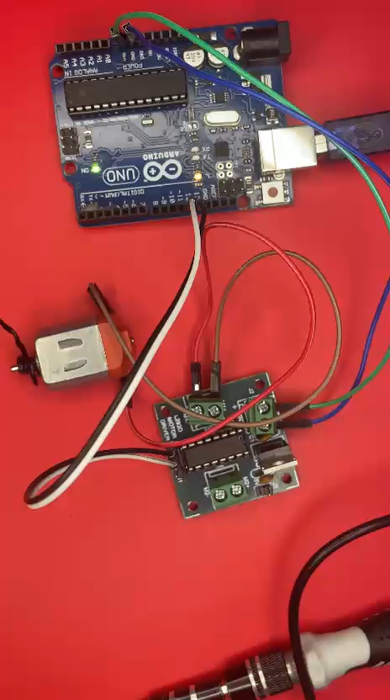
Working

Slide 5
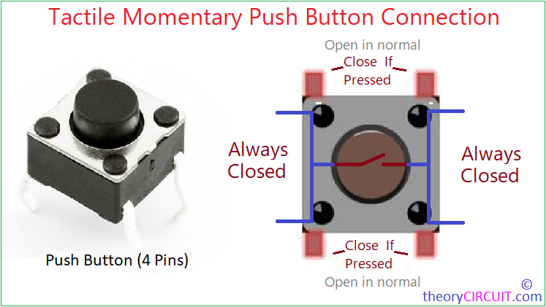
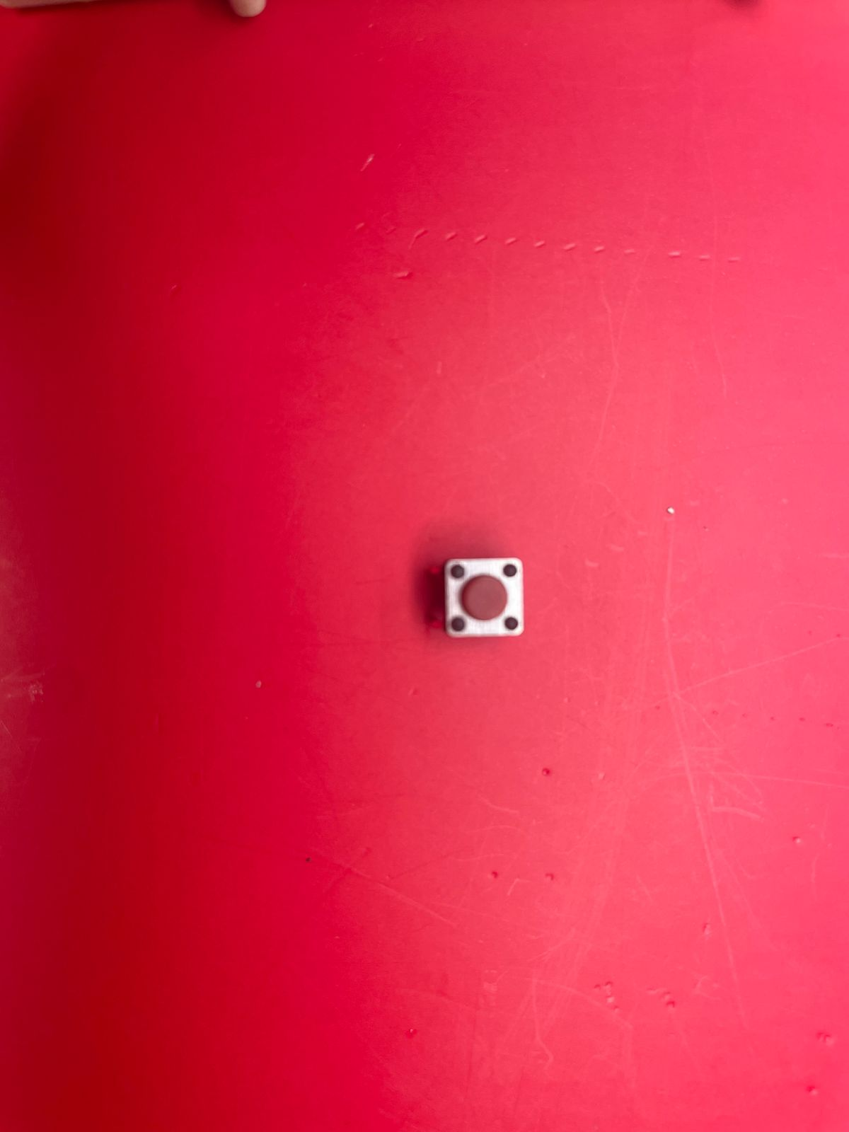
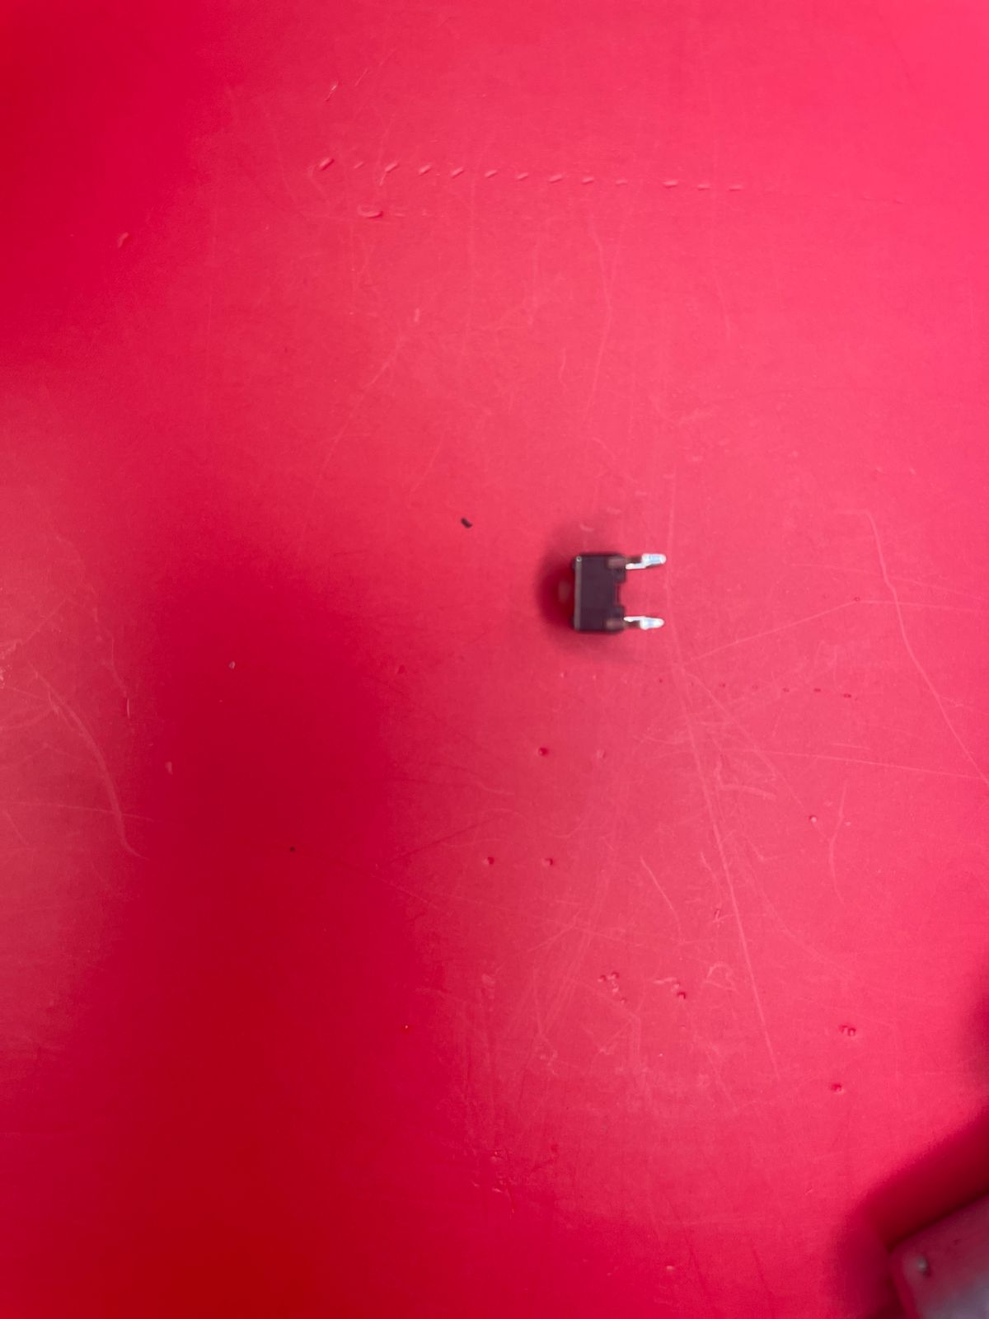
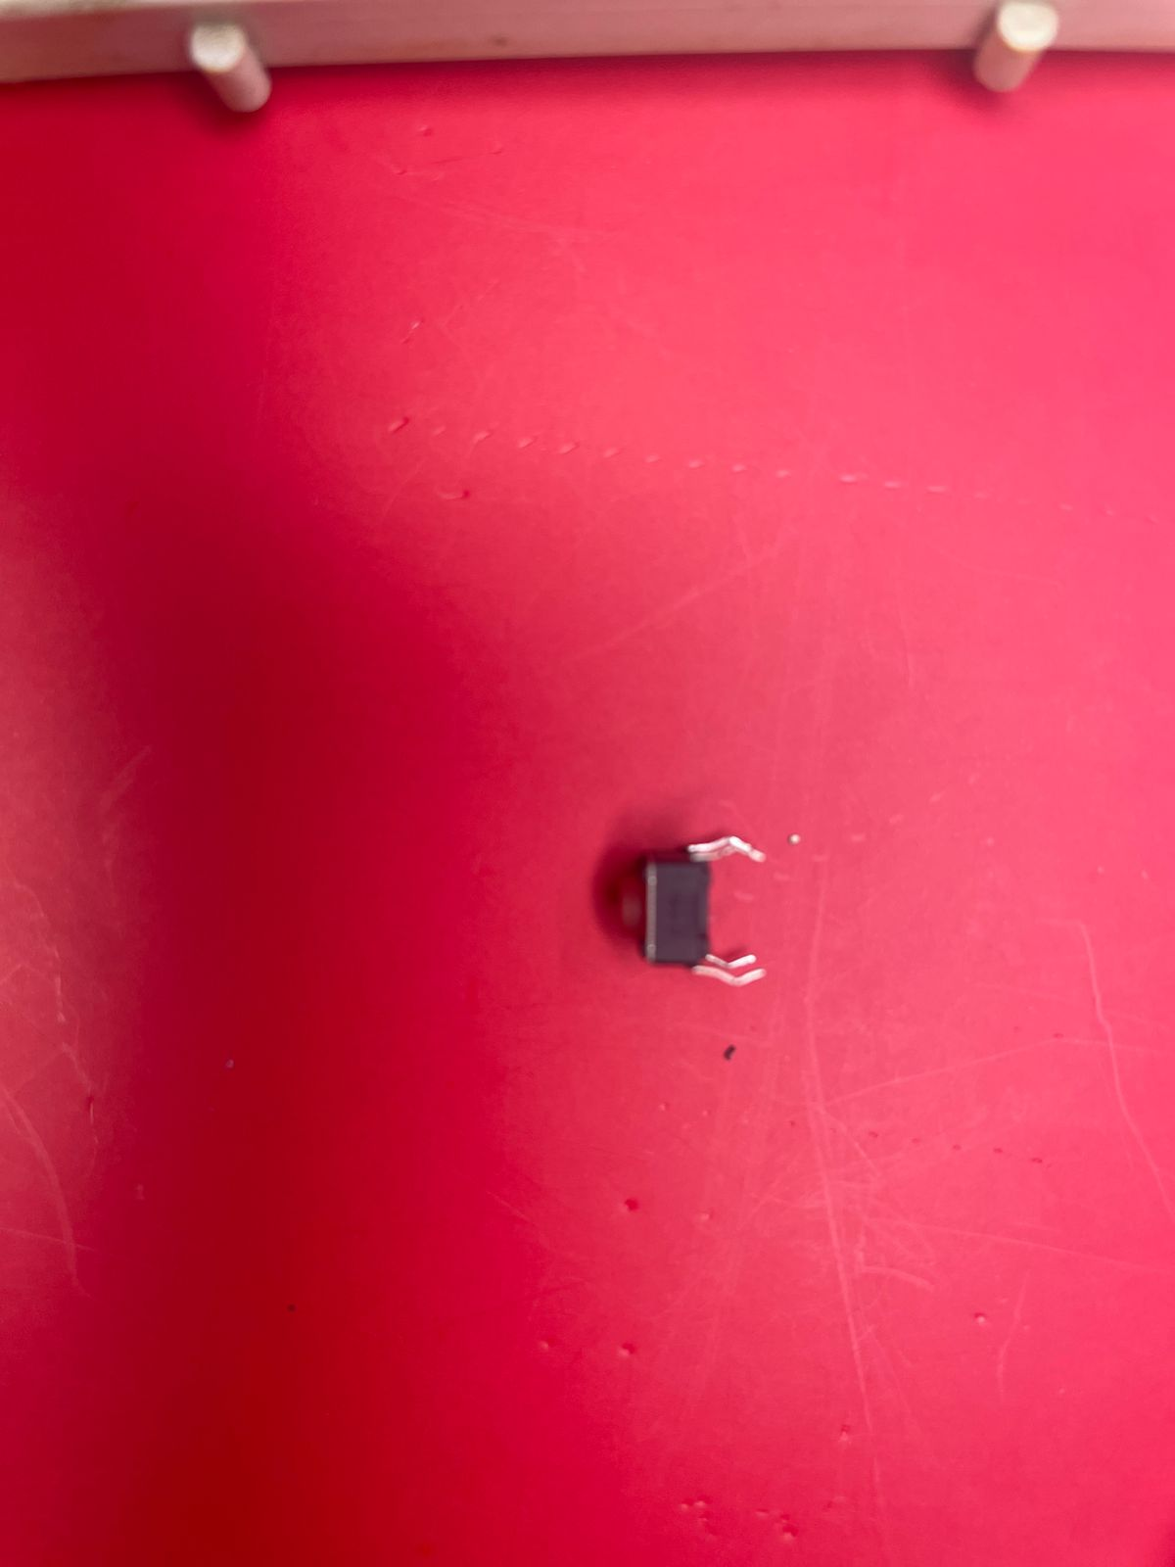
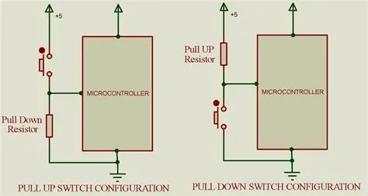
Lets Connect a Push Button

Slide 6
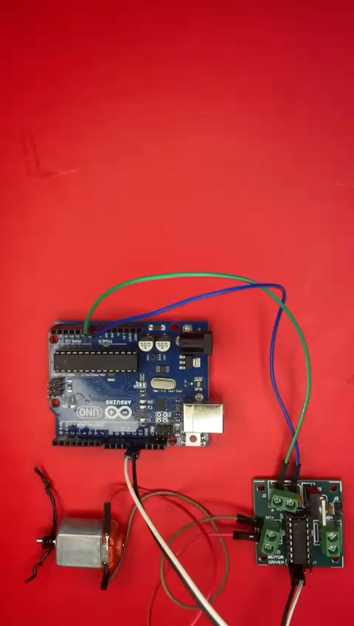
Connections

Slide 7
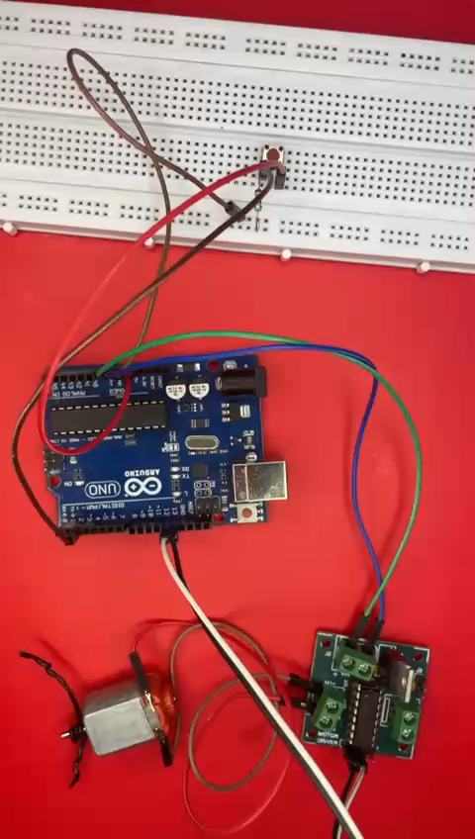
Working

Slide 8
THANK YOU

